Slide 1
Relationship Between Hospital’s Accessibility via Subway Trains and Inpatient Demographic Groups in New York City
Yizhou Guo & Shujun Jin

Slide 2
Objectives
Investigate the relationship between hospital accessibility via subway networks and inpatient demographics (age, gender, race) in NYC to:
Identify disparities in healthcare accessibility.
Analyze the role of subway connectivity in influencing hospital visits and demographic diversity.
Key Focus from the Status Report Feedback:
Investigate the differences in network metrics between the station network weighted by our custom metric and the network weighted by geographical distance.
Examine the relationship between the inpatient data and the network metrics of the stations closest to that hospital.

Slide 3

Materials
Datasets:
Subway System Network:
MTA Subway Stations | State of New York
MTA Subway Service Delivered: Beginning 2020
Inpatient demographics: New York State Hospital Inpatient Discharges 2022
Key Columns for Use: (e.g.)
Hospital Service Area + Permanent Facility ID + Facility Name (For Grouping)
Age Group + Gender + Race (Demographic Characteristics)

Slide 4
Methods
Network Analysis:
Constructed single-mode, undirected subway networks.
Two network weights:
Geographical distance
Custom formula
Demographic Analysis:
Grouped inpatient data by hospitals and regions.
Analyzed demographics (age, gender, race) using Python.
Generated pie charts for visualization.
Combined Analysis:
Used regression to examine relationships between subway connectivity and:
Diversity score of the facilities.
Number of inpatient visits. .

Slide 5

Metrics
Closeness centrality (NetworkX)
Betweenness centrality (NetworkX)
Connectivity Score
Diversity Score (Shannon Diversity Index)

Slide 6

Network (Geographical Distance as Weight)

Slide 7

Network (Custom Formula as Weight)

Slide 8
Network
Geographical Distance as Weight
Custom Formula as Weight

Slide 9
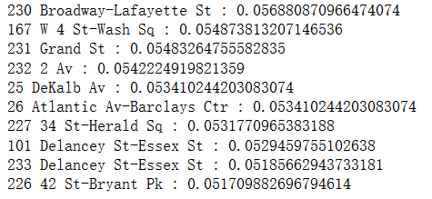
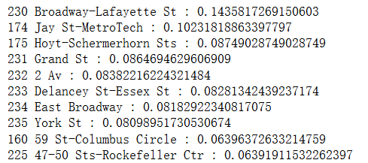
Network
Closeness centrality (Top 10)
Betweenness centrality (Top 10)

Slide 10
Results
Demographic Statistics:
Age Group Trends: NYC shows a balanced representation across age groups, while regions like the “Capital/Adirond” and “Long Island” demonstrate a higher proportion of older adults (70 or older).
Younger Patient Profile in New York City
Gender Comparison: Gender distribution across NYC and other regions is consistently close to an even split, with a slight predominance of female patients.
Gender Consistency
Race Distribution Differences: NYC shows a more balanced racial distribution compared to other regions.
Broader Accessibility and Varied Healthcare Needs
Notes:
NYC’s diverse inpatient demographics suggest broader accessibility and varied healthcare needs driven by the city’s dense and heterogeneous population. In contrast, rural and suburban areas with higher proportions of older adults may face challenges in addressing the healthcare needs of aging populations, particularly due to limited infrastructure. Statewide, similar gender engagement patterns in healthcare utilization indicate consistent access among male and female populations.

Slide 11
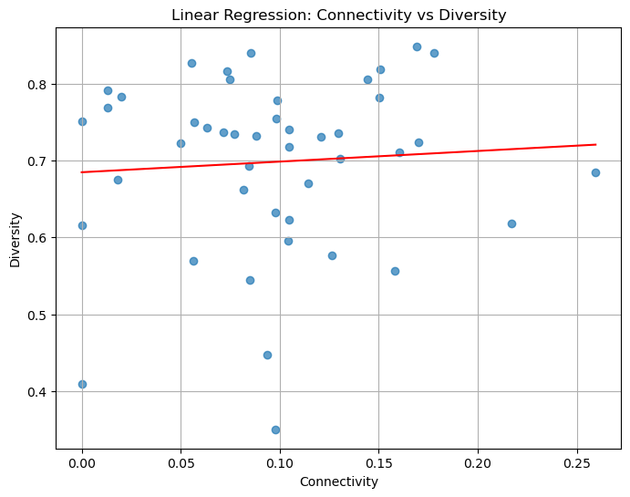
Results
Diversity = 0.14 * Connectivity + 0.68
(p= 0.649)
Positive trend, but not statistically significant.
Suggests connectivity might influence diversity.
Notes:
Linear regression revealed a weak positive relationship between subway connectivity and diversity scores. Hospitals with better subway access tended to have more diverse inpatient populations, though the p-value suggested the trend was not statistically significant.

Slide 12
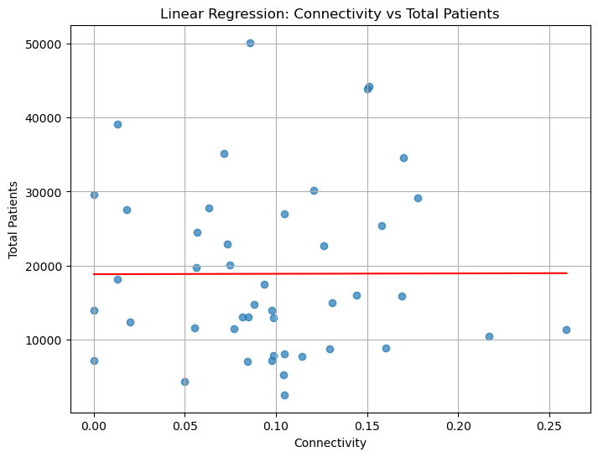
Results
Total Patients = 551.19 * Connectivity + 18844.03 (p= 0.986)
No linear relationship observed.
Notes:
The relationship between connectivity and total inpatient volumes was negligible, indicating that factors like hospital capacity or specialization might play a greater role.

Slide 13
Conclusion
Subway systems enhance hospital accessibility and diversity but are not the sole determinants of patient demographics.
From Diversity vs. Connectivity Analysis:
Connectivity correlates with diversity trends, but other factors (e.g., hospital capacity, specialization) likely play a larger role.
From Patient Volume vs. Connectivity Analysis:
No clear linear relationship observed.
External variables (e.g., hospital location, competition) might affect volumes.
Integrated planning for healthcare and transit systems is needed to address disparities, especially in rural regions.
From Inpatient Demographics Analysis:
NYC hospitals are more accessible and diverse.
Rural/suburban hospitals face challenges in infrastructure and serve older populations.
Future research should consider other factors like socioeconomic factors, hospital specialties and capacities, etc.

Slide 14
Threats to Validity
Population Distribution
E.g. Downtown manhattan has higher density than Queens
Size of a hospital
E.g. VUMC vs SHC
Specialty of a hospital
E.g. Children’s hospital may not have patients over 70 years old

Slide 15
Q&A

